Slide 1
LOAN PREDICTION
Introduction and Problem Statement
Data Dictionary
Data Pre-Processing
EDA Insights
Model Evaluation and Accuracy

Slide 2
Introduction and Problem Statement
Predict Loan Eligibility for Dream Housing Finance company
Dream Housing Finance company deals in all kinds of home loans. They have presence across all urban, semi urban and rural areas. Customer first applies for home loan and after that company validates the customer eligibility for loan.
Company wants to automate the loan eligibility process (real time) based on customer detail provided while filling online application form. These details are Gender, Marital Status, Education, Number of Dependents, Income, Loan Amount, Credit History and others. To automate this process, they have provided a dataset to identify the customers segments that are eligible for loan amount so that they can specifically target these customers.
Overview of the Data:
Number of Entries: 614
Number of Features: 13

Slide 3
Data Dictionory
Train file: CSV containing the customers for whom loan eligibility is known as 'Loan_Status'
Variable | Description
Loan_ID | Unique Loan ID
Gender | Male/ Female
Married | Applicant married (Y/N)
Dependents | Number of dependents
Education | Applicant Education (Graduate/ Under Graduate)
Self_Employed | Self employed (Y/N)
ApplicantIncome | Applicant income
CoapplicantIncome | Coapplicant income
LoanAmount | Loan amount in thousands
Loan_Amount_Term | Term of loan in months
Credit_History | credit history meets guidelines
Property_Area | Urban/ Semi Urban/ Rural
Loan_Status | (Target) Loan approved (Y/N)

Slide 4
Data Cleansing
1. Handling Null Values:
Identified the number of null values in each column.
Replaced null values.
Mean for numerical columns.
Mode for categorical columns.
2. Column Encoding:
Applied Label Encoding to binary and multi-value categorical columns (e.g., Gender, Marital Status,Education, Property_Area).
One Hot Encoding.
3. Handling Class Imbalance:
Applied SMOTE to oversample the minority class to balance the dataset.

Slide 5
EDA Insights
The loan approval count for males is higher compared to females.
Loans are more likely to be approved if the applicant has no dependents.
Married individuals have a higher likelihood of loan approval.
Graduates have a better chance of loan approval compared to non-graduates.
Loans are less likely to be approved for self-employed individuals.
Semi-urban properties have the highest count of loan approvals compared to rural and urban properties.
There is a high dependency of credit history on loan status, indicating that a good credit history significantly increases the chances of loan approval.
The scatter plot indicates that most loans have a Coapplicant Income of less than 10,000 and a Loan Amount below 200.

Slide 6
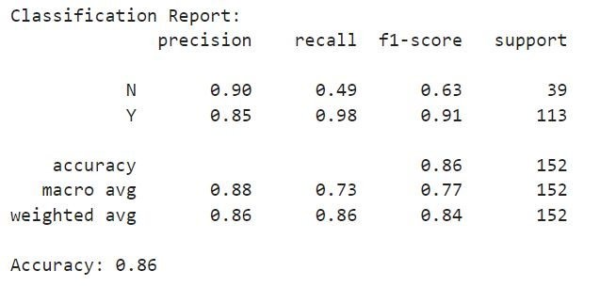
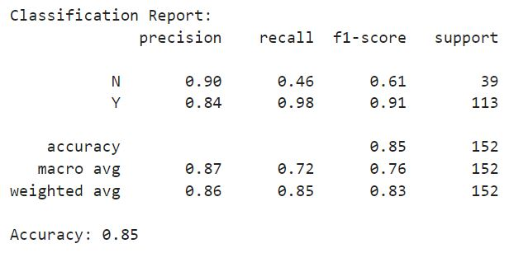
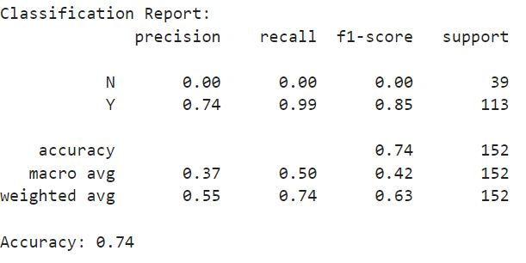
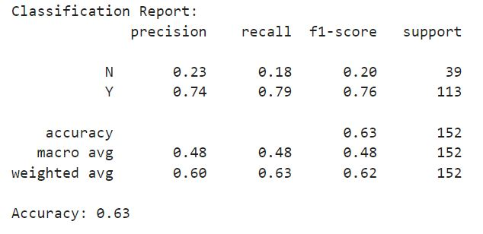
Model Evaluation
Random Forest Classification
Logistic Regression
Support Vector Classification
KNN Classification

Slide 7
Conclusion
The RandomForest model shows good performance with an overall accuracy of 81%. The precision, recall, and F1-score are high for the 'Y' class (loan approved), indicating that the model is very effective in identifying approved loans. However, the recall for the 'N' class (loan not approved) is lower at 47%, meaning the model has difficulty correctly identifying loans that should not be approved.
Precision for 'N' is high, suggesting that when the model predicts a loan should not be approved, it is correct 86% of the time.
Recall for 'Y' is very high, indicating that the model successfully identifies nearly all loans that should be approved.
F1-score is a balance between precision and recall, with higher values for the 'Y' class showing strong performance in identifying approved loans.

Slide 8
THANK YOU

